Slide 1


Comparing Traditional Machine Learning and LLM ICL on Structured and Text Tasks
DDA 5001
Group 10

Slide 2
Research Framework
Research Objectives
We conducted a systematic comparison between traditional machine learning methods (e.g., KNN, SVM, Random Forest) and Large Language Models (LLMs) using In-Context Learning (ICL).
Mainly focusing on two types of tasks: Structured Data Classification (Iris, Digits, Wine)；Text Classification (AG News, SST2, TREC)
Three Core Experiments:
Performance Comparison: Traditional ML vs. ICL across 6 public datasets
Model Comparison: ICL performance across different LLM sizes and architectures.
Prompt Optimization: Impact of prompt length on ICL accuracy.

Slide 3
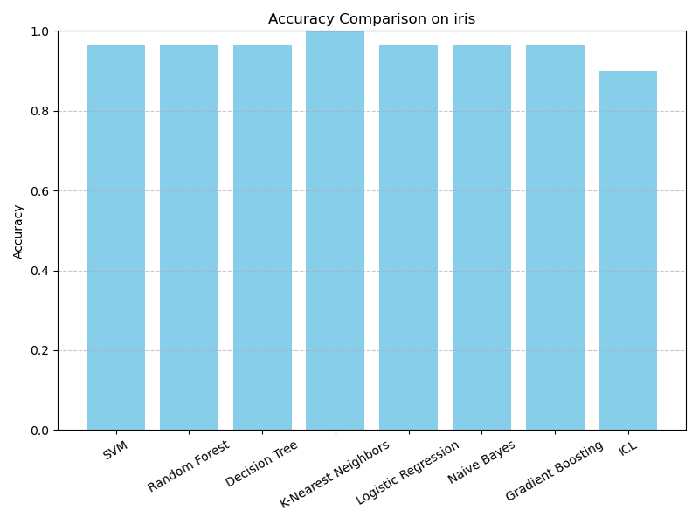
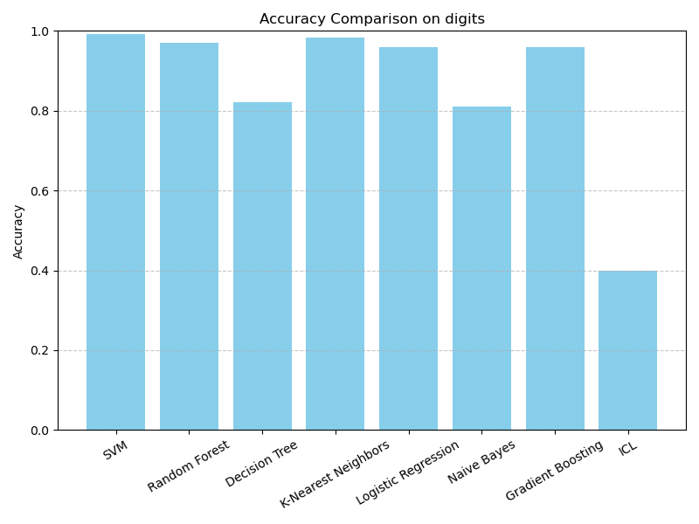
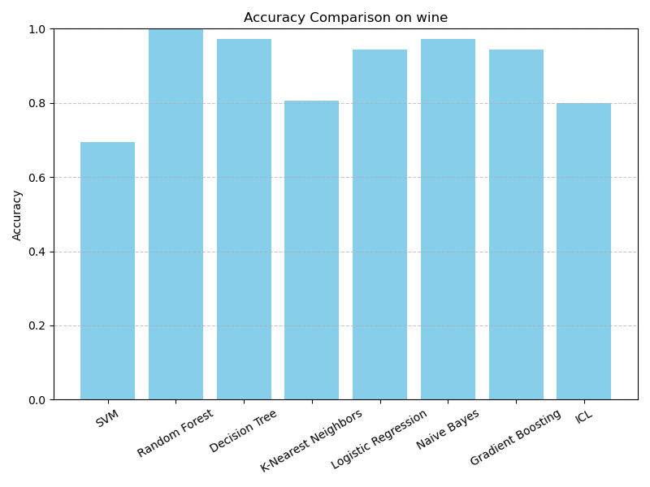
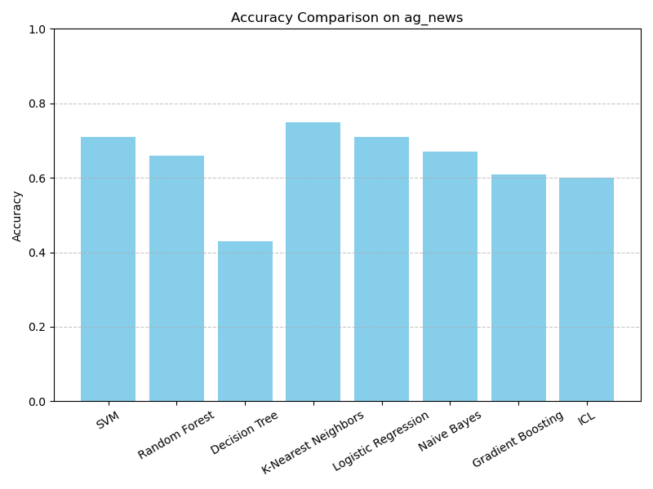
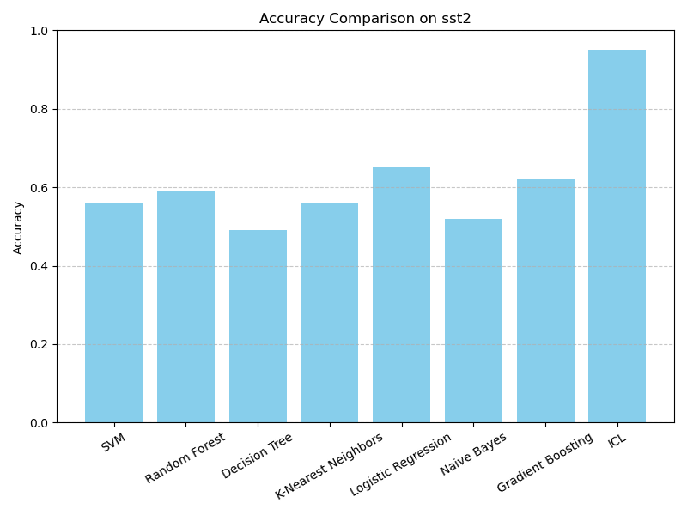
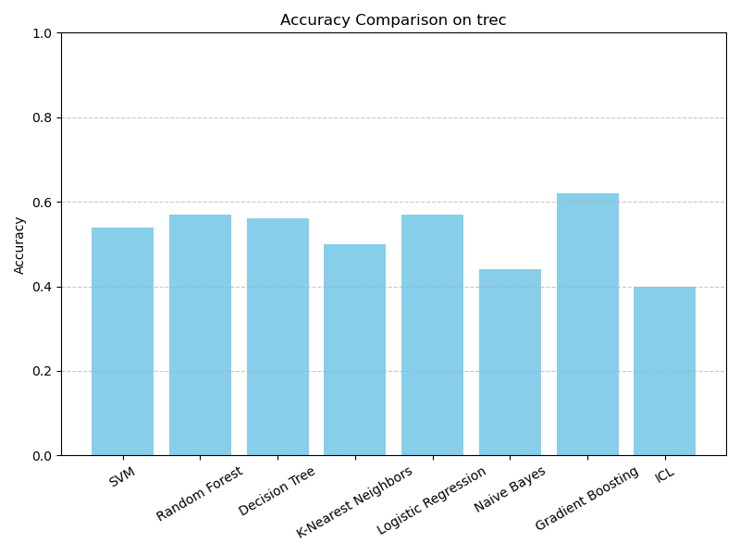
Comparison of Accuracy between Traditional ML Methods and ICL
Structured Datasets
Text Classification Datasets

Slide 4
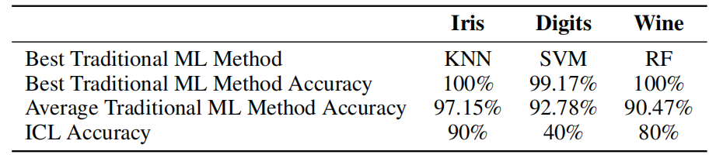
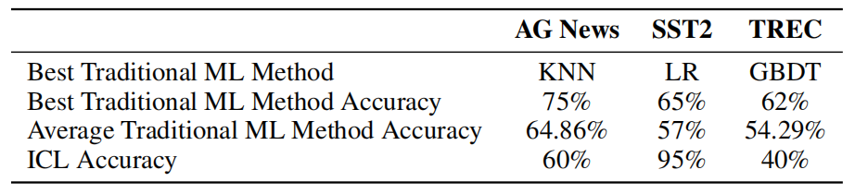
Key Findings on ICL vs. Traditional ML Performance
Performance Boundaries of ICL
Structured Data: Traditional ML (e.g., KNN, SVM, RF) outperforms ICL (70% avg, drops to 40% on Digits).
Text Data: ICL excels in semantic tasks (e.g., SST2: 95% vs. 65%) but lags in classification (AG News, TREC).
Structured Data
Text Data
Task-Method Alignment is Critical
ICL thrives on subjective, semantic tasks (e.g., sentiment analysis).
Struggles with precise knowledge/complex reasoning.
Task-Method Alignment is Critical
ICL and traditional ML are mutually enhancing; future work should focus on task-method matching frameworks.

Slide 5
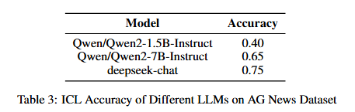
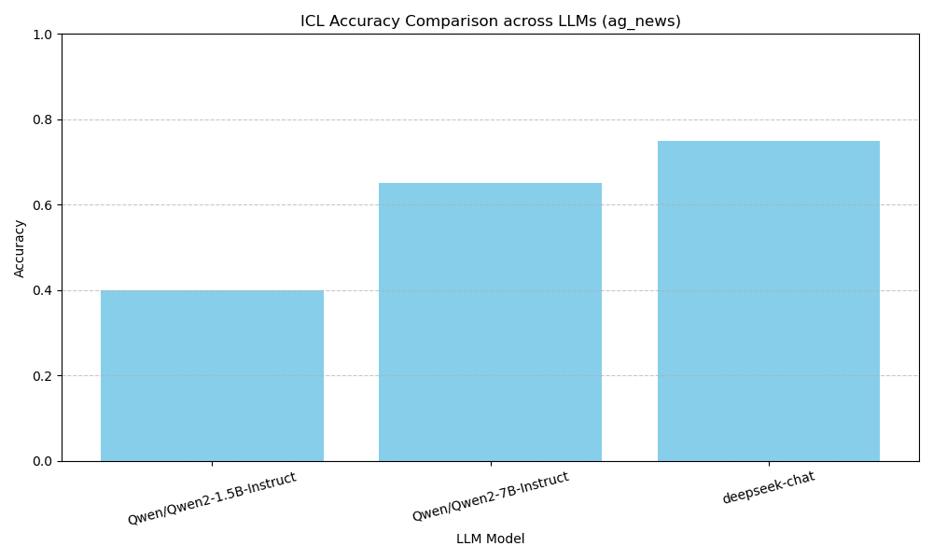
COMPARISON OF ICL ACCURACY ACROSS DIFFERENT LARGE LANGUAGE MODELS
Core Insights
Impact of Model Size
7B Model (Qwen2-7B) significantly outperforms the 1.5B model (Qwen2-1.5B), achieving 0.65 vs. 0.40 accuracy
Demonstrates that larger models exhibit stronger pattern recognition and generalization in ICL tasks
Importance of Architecture & Instruction-Following
Deepseek-chat (not the largest model) achieves the best performance (0.75 accuracy)
Highlights that architectural optimizations and instruction fine-tuning matter more than sheer scale
Diminishing Returns on Scaling
1.5B → 7B: +25-point gain | 7B → Deepseek-chat: +10-point gain
Beyond a certain size, architectural improvements outweigh further parameter increases

Slide 6
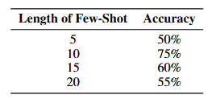
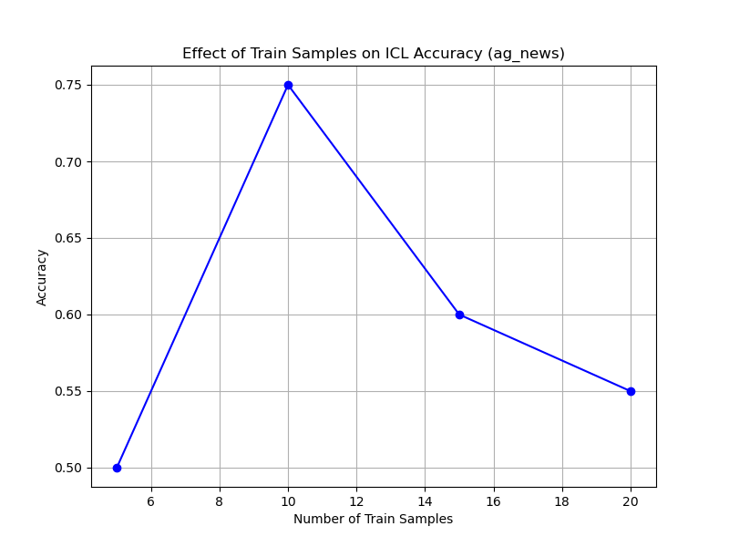
Impact of Few-Shot Length on ICL Accuracy
Core Insights
Prompt length has a significant non-linear impact on ICL effectiveness, with 10-shot prompting achieving optimal performance for AG News classification.
Both too few (insufficient context) and too many (cognitive overload) examples degrade model accuracy, forming an inverse U-shaped curve.
Practical Implications
Task-specific prompt length tuning is critical—longer prompts do not always improve performance.
Balancing contextual information and processing efficiency is key to maximizing ICL.

Slide 7
Thanks

